Slide 1
Illinois School Finance
Presented by:
Rebecca allard
interim assistant superintendent
finance, facilities and operations
March 17, 2016

Slide 2
Board of Education
Financial Responsibilities
The Board is the “voice of the community”
  Establish the outcomes and priorities that are reflected in the budget
  Communicate to the community that budget reflects its expectations

Slide 3
School District Budget Process
Budget process is governed by the Illinois School Code
  The budget is comprised of revenues and expenditures in a format defined by the Illinois State Board of Education (ISBE)

Slide 4
All Financial Decisions Are Approved
By The
BOARD OF EDUCATION
Committees Make Recommendations

Slide 5
Forward Thinking
What is the current
status of
District 41’s Financial position

Slide 6
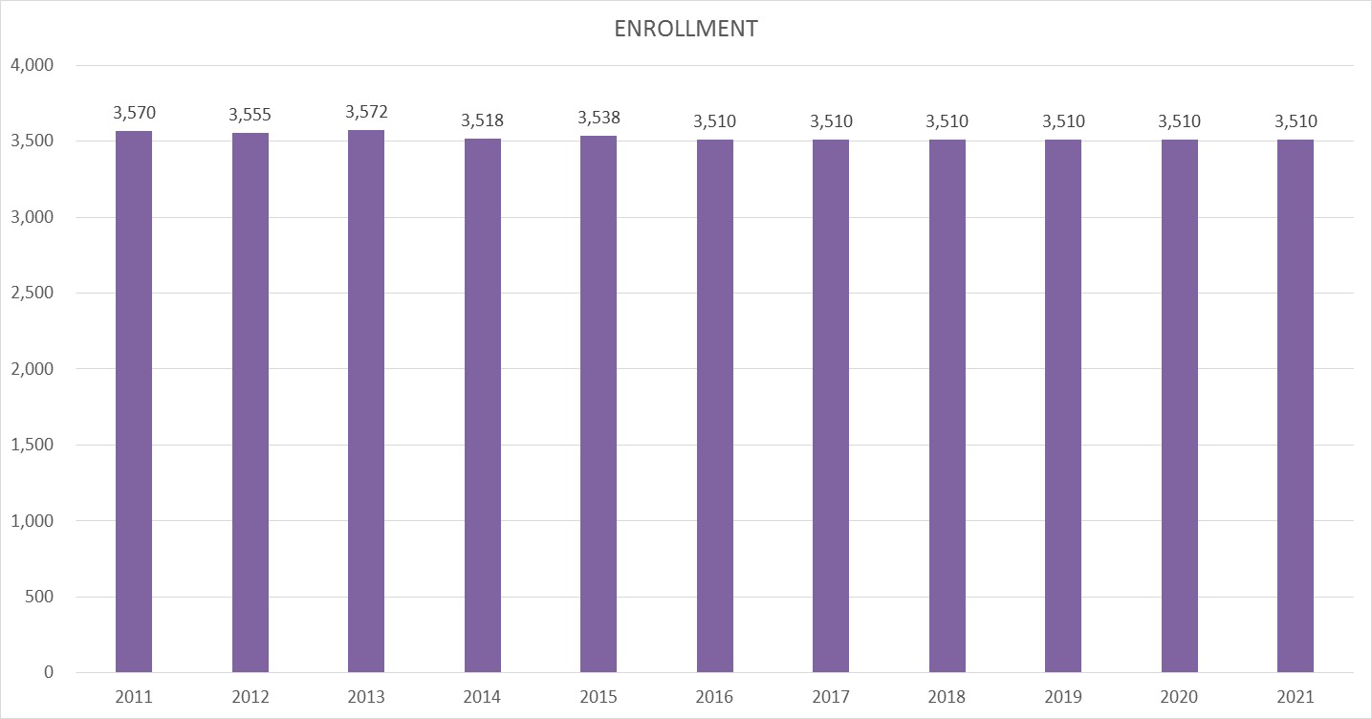
Enrollment

Slide 7
FY 16 Revenue Source by Detail

Slide 8
FY 2016 Expenditures by Object

Slide 9
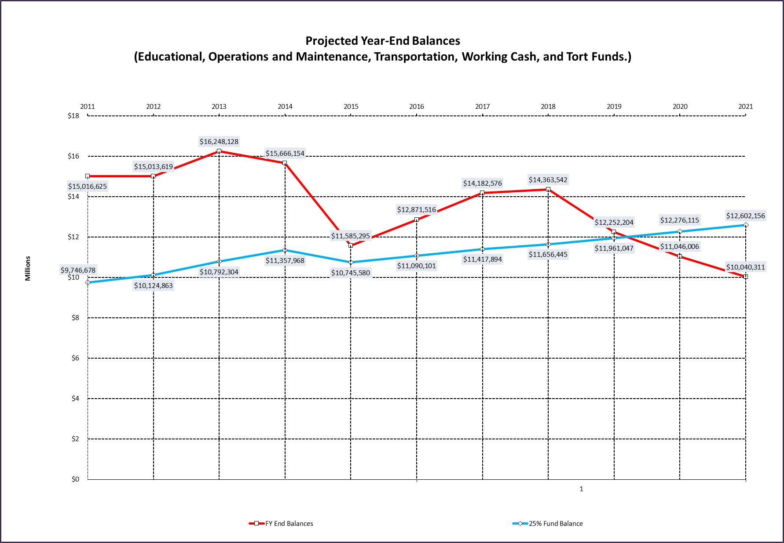
Base Case

Slide 10
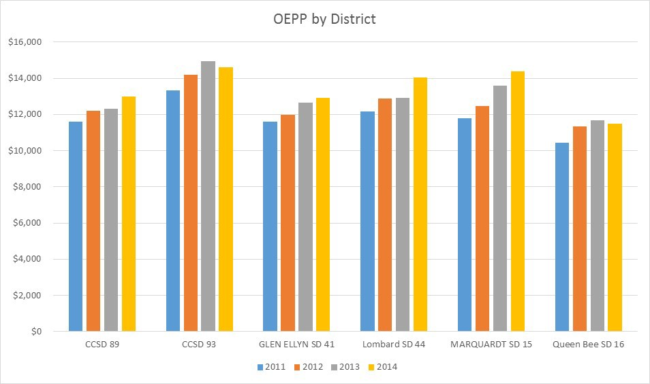
Operating Expense per Pupil
Source of Information: ISBE AFR

Slide 11
Current Debt
How does a District finance
facility renovations

Slide 12
Outstanding Debt
Referendum Debt – Debt Service Fund
  2004 General Obligation Refunding Bonds final payment 2/1/2017
  1998 General Obligation Capital Appreciation Bonds final payment 2/1/2018
  Final tax year 2016
  2014 tax rate $0.25 per $100 of Equalized Assessed Value (EAV)
Non-Referendum Debt – O & M Fund
  2014 Debt Certificates ($7,000,000 – 15-year term)
  Average Annual Payments ($625,000)

Slide 13
Other Debt Issuance Options
The District can issue bonds without a referendum to fund capital projects, if the debt service payments fit within the “Debt Service Extension Base”.
  Current amount available is approximately $6 million (20 year repayment schedule)
The types of limited bonds are:
Working Cash Fund Bonds | Life Safety Bonds | Funding Bonds
Can be used for capital or operating purposes Requires a petition period and a public hearing | Proceeds must be used for life safety projects only Requires a public hearing | Can be used to refund debt obligations such as leases or debt certificates Requires a public hearing

Slide 14
Questions

